Slide 1



Towards Network Implementation of CBR:
Case Study of a Neural Network K-NN Algorithm
Xiaomeng Ye, David Leake, Yu Wang, Ziwei Zhao, and David Crandall

Slide 2
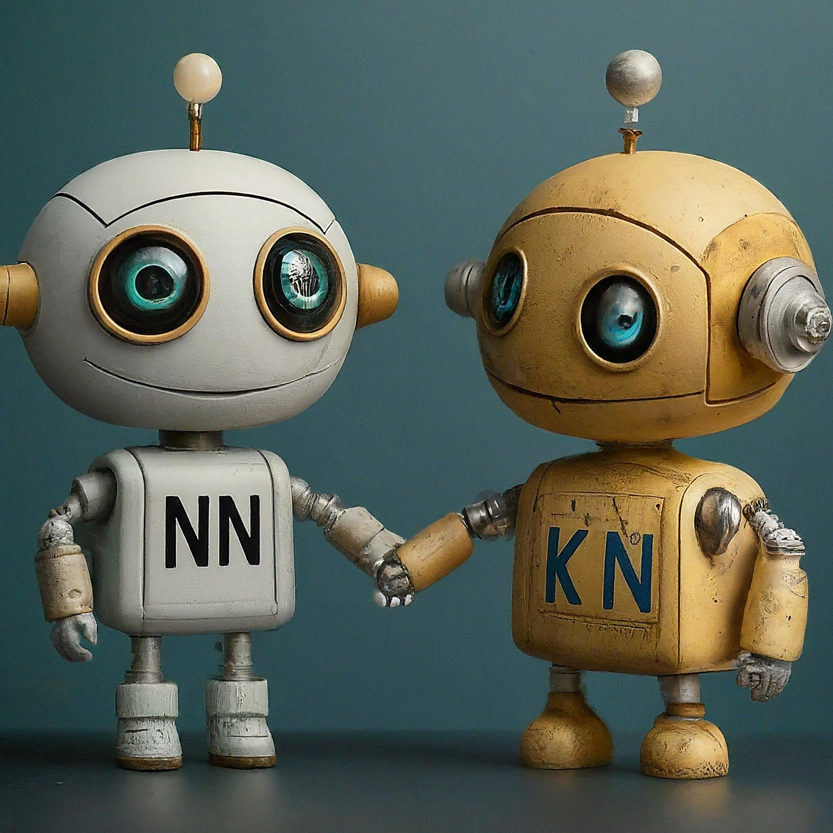
In Brief

Slide 3
Overview
This presentation answers six questions:
Why develop NN-kNN?
How to build it?
What's the benefit of using it?
How well does it work?
What's the downside of using it?
What's down the road?

Slide 4
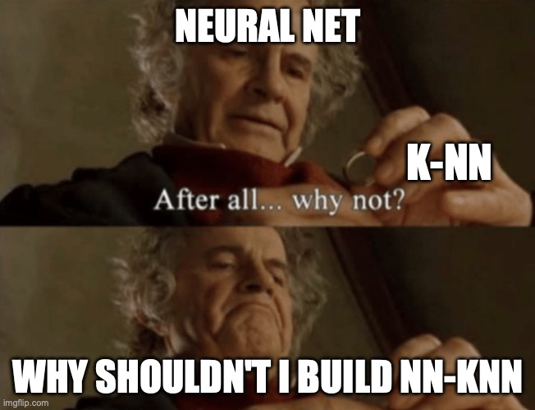
Why?
Why not?

Slide 5
Why NN-kNN? A. Advantages over traditional k-NN Implementations
Neural networks have certain benefits over traditional k-NN implementations:
Training scheme (minimizing loss), network structures (for feature extraction, hidden pattern learning), parallel computing (fast in training), active learning (fast in testing), can chain with other neural network modules (CNN + classifier)

Slide 6
Why NN-kNN? B. Advantage over NNs for Interpretability
K-NN is fully interpretable, NNs are (usually) black box.
Each k-NN solution is supported by selected nearest cases.
The core k-NN computation is a simple human-understandable distance calculation
"Cases are king" for CBR interpretability (Gates, Leake, Wilkerson 23), so identifying cases contributing to solution may be sufficient
Feature weights can provide additional information

Slide 7
Why NN-kNN? C. Addressing a CBR Challenge
1-NN case selection is often the retrieval process for CBR
End-to-end network CBR implementations enable coordinated learning
CBR performance benefits if similarity and adaptation are synchronized (e.g., Smyth & Keane 1998, Leake, Kinley & Wilson 1997)
This can be approximated for network CBR by alternating optimization (Leake & Ye, 2021)
If both retrieval and adaptation are implemented by NNs, the two NNs can be chained together and trained in synch.
An issue: We just black-boxed a white-box CBR system. We made a CBR system into a neural network.
Solution? Make the neural network interpretable!

Slide 8
Why? Related Work
Neural models are used extensively for processes psuch as index generation, similarity assessment, and case adaptation. Powerful but black-box
NN-kNN response: Design a neural architecture to force interpretability
Inspiring example: Li et al. (2018) interpretable network for image classification explains predictions by a restricted set of learned prototypes. It encodes features, learns prototypes, and reconstructs images as explanations. Appealing but prototype approach has limitations:
Learned prototypes may not correspond to any real examples and may blend several classes, making them less understandable or convincing as explanations
A specific example may not be covered by any sufficiently similar prototype
NN-kNN response: Generalizing it to use cases instead of prototypes (Potentially, you can still use only prototype cases, for a smaller case base)

Slide 9
Why? Related Work
"CBR is a methodology, not a technology" (Watson, 1999)
NN-kNN illustrates networks inspired by CBR processes (Leake & Crandall, 2020).

Slide 10
Why? Related Work
Li et al. (2018): An interpretable network for image classification which
Explains predictions by a restricted set of learned prototypes.
Encodes features, learns prototypes, and reconstructs images as explanations.
Limitations of learning prototypes:
Reasoning with encodings makes underlying reasoning opaque
The learned prototypes
may not correspond to any real examples, and
may blend several classes
This may make them less understandable or convincing as explanations
A specific example may not be covered by any sufficiently similar prototype
NN-kNN response: Use real cases instead of learning prototypes!

Slide 11
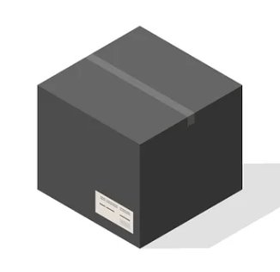
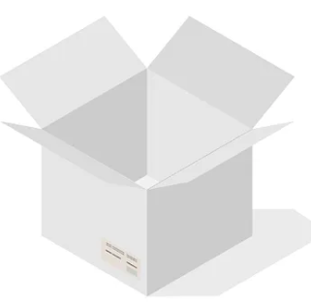
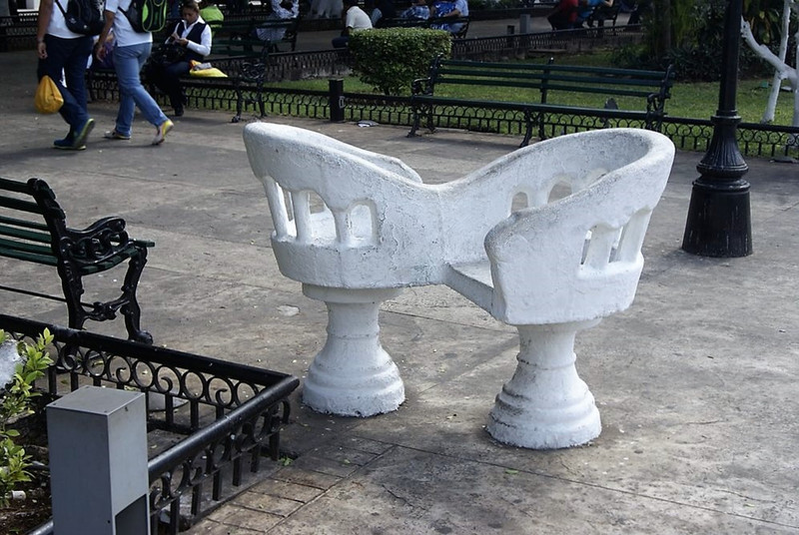
Why? (summary)
We want a black-box neural network to function like a k-NN system (a step towards network-implemented CBR)
We want it to retain CBR interpretability, turning the black box into a white box
This duality provides benefits from both sides
(And drawbacks too, which we will discuss)
“Tú y Yo” CBR-kNN
Notes:
Boxes image from https://shahdarshit88.medium.com/black-box-vs-white-box-testing-key-differences-93ee1d70453a

Slide 12

How?
Neural Nets are universal approximators. So we can emulate almost any function (with limited memory).
A good example: Logical Neural Net (Nodes represent logical operations)
We can emulate a k-NN with a NN.

Slide 13
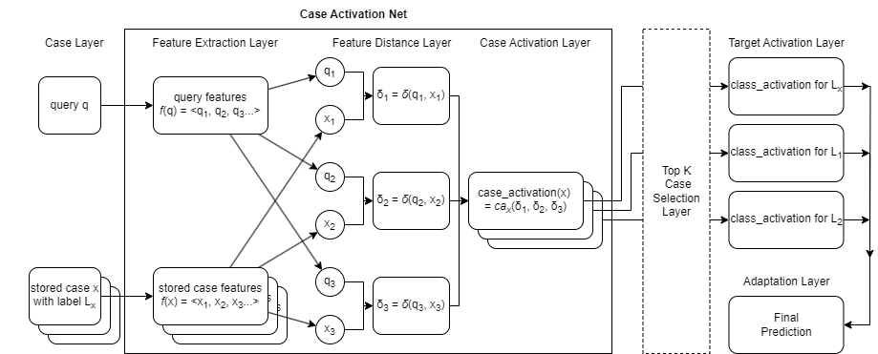
Neural Network Based K-Nearest Neighbor

Slide 14
The input query goes here

Slide 15
Cases are stored here

Slide 16
Features may be extracted (e.g. using a CNN) or surface features (tested in our experiment)

Slide 17

Feature distance for each feature of each case

Slide 18
Case activation calculated for each case

Slide 19
Optionally, select only the top k activated cases. All other activations set to 0.

Slide 20
For classification, cases contribute to corresponding classes

Slide 21
Adaptation. Here very simple, e.g. Choose highest activated classes (Note Power-interpretability tradeoff)

Slide 22
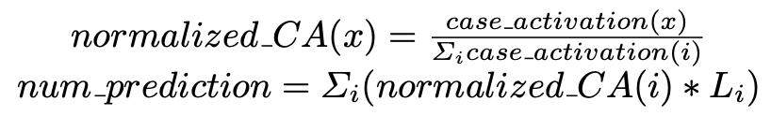
NN-KNN also Supports Regression
Same function for case activation net
The target activation layer and adaptation layer are a single neuron. Its output num_prediction is the final prediction (a number).
An example final layer is a weighted average of the activated cases' labels, where the weights are based on case activations.

Slide 23
Intuitive Explanation
NN-kNN is composed of:
A layer that calculates feature distances
A layer that calculates case activations using feature distances
(case activation really is just the inverse of case distance)
A layer that activates classes based on activated cases
A final layer to summarize/adapt all classes
The following slides illustrate how these can implement different kNN variants

Slide 24
For a simple vanilla k-NN, choose unweighted f(), δ() and ca().

Slide 25
NN-kNN can provide feature weighting (local or global) and ...
wx1
wx2
wx3

Slide 26
… case weighting, …
wx1
wx2
wx3

Slide 27
… and more
User chooses the feature distance function, case activation function, target activation function, or adaptation function
User chooses the weighting to be local/global. A weighting can be a numeric parameter, or even a function of the query
The only requirement: That these are trainable with backpropagation.
This freedom is a benefit inherited from using the NN implementation

Slide 28
Summary of NN-kNN
NN-kNN implements a generalized k-NN. It has:
Local/global weighting
Feature weighting
Case weighting
User may disable any of the above, by setting the corresponding parameters to a fixed constant value.
User may also chain additional modules for different purposes, E.g. adding a feature extraction module at the front, or modifying the target/adaptation layer at the end for a special adaptation rule.

Slide 29
Benefits of NN-kNN
Fully intrepretable as a k-NN: Can show similar features and highly activated cases.
Powerful like a normal NN: NN-kNN is trained to minimize a loss using back propagation.
Harmonizes different components of CBR. We can train feature weighting and case weighting together; We can also train retrieval and adaptation together.

Slide 30
Evaluation
Does NN-kNN provide accuracy comparable to other models? Specifically, we want to compare it with a standard NN, and a k-NN using state-of-the-art metric learning algorithm.
Are the cases activated by NN-kNN good explanations for the model’s final decision? Potentially, NN-kNN as a neural network could make correct predictions for the wrong reasons

Slide 31
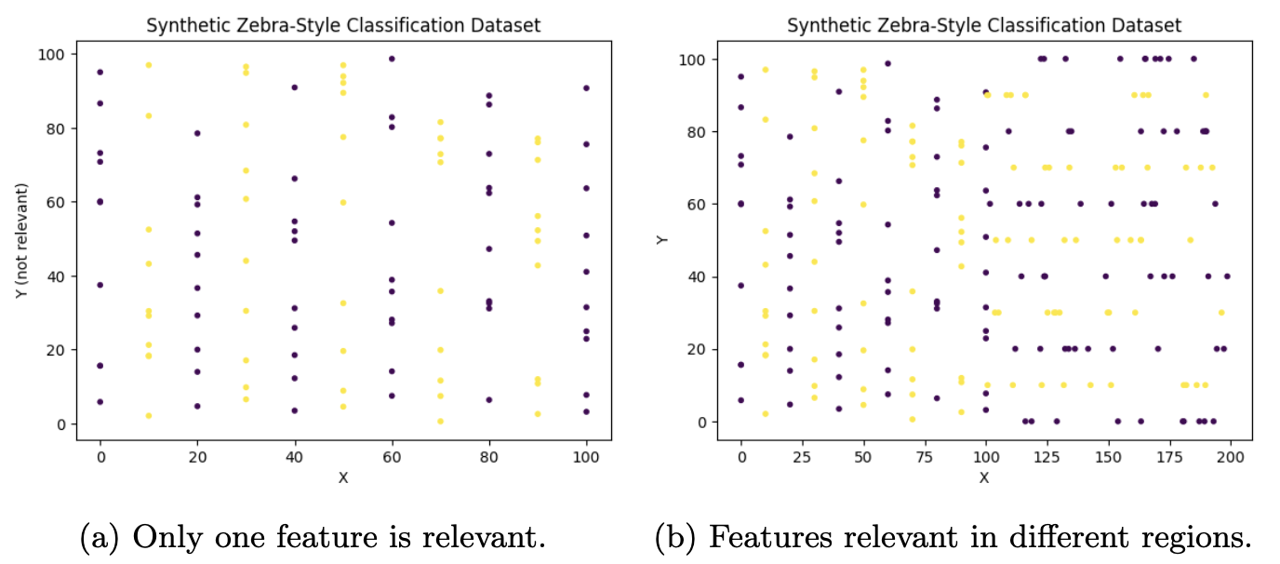
Evaluation
Compared NN-kNN to a vanilla k-NN, Neighborhood Components Analysis (NCA) and Large Margin Nearest Neighbor (LMNN). NCA and LMNN can be considered as state-of-the-art k-NN methods.
Also compared to a neural net of similar complexity.
Parameter settings are in paper

Slide 32
Evaluation
Data sets: Sample small standard tabular data sets, for classification and regression.
Two additional generated dataset (zebra patterns shown top right)
Zebra (a), only feature X is important while Y is irrelevant
Zebra (b), X is important when X < 100, and y is important when X > 100.
They test models' ability to learn a local weighting (local landscape).

Slide 33
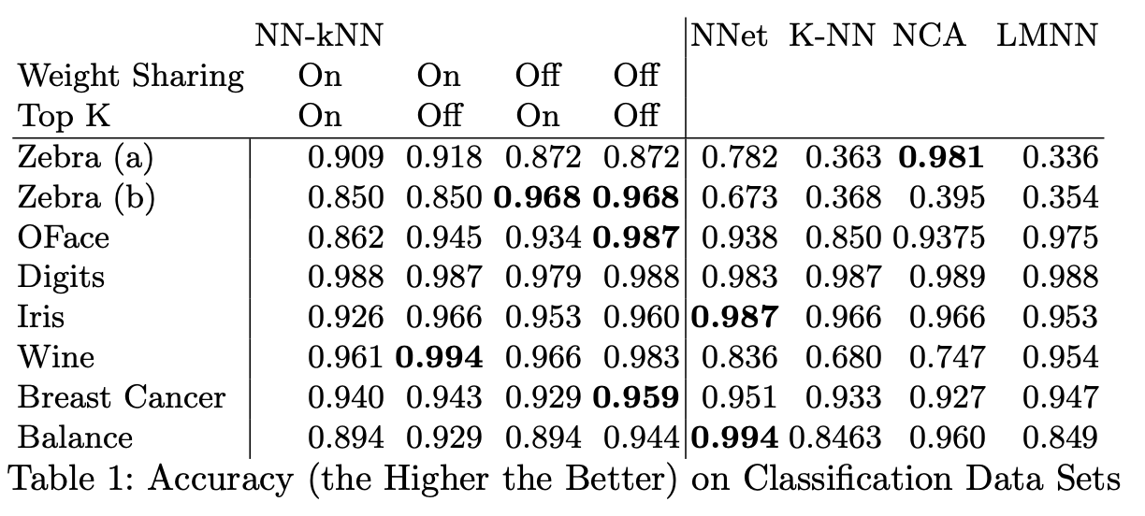
Results on classification data sets

Slide 34
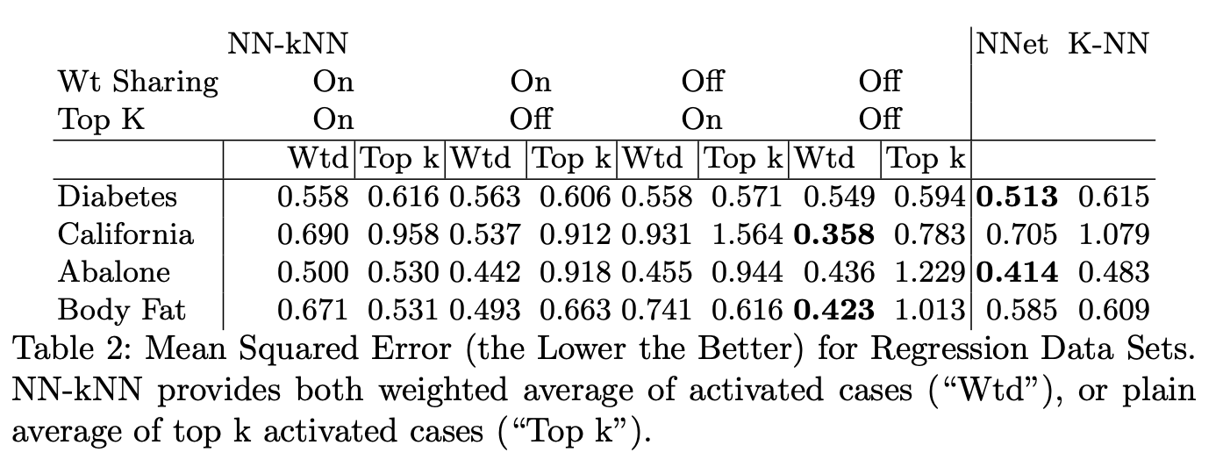
Results on Regression Data Ses

Slide 35
Discussion of Results: Accuracy
NN-kNN performs relatively well across all data sets.
NN-kNN is inherently a neural network with preset neurons (in the case layer), connections (e.g. one case only activates a corresponding class) and preset-but-tunable parameters (weights and biases).
It might appear that NN-kNN would sacrifice performance because the preset connections and parameters constraints limit degrees of freedom.
However, NN-kNN can perform as well as, or even better, than the baseline neural network, as the preset neurons and connections function are symbolic knowledge being used by the model. For example, the model may easily find a similar case because the architecture already establishes a starting point for distance metric and case bases.

Slide 36
A Metaphor
You teach a kid by some grounding cases and then let it train in the wild.
"Chasing is OK" but "Hitting is bad" (Cases in NN-kNN)
Your kid starts with some basic grounded hard-baked rule, starts mingling with other kids, and (hopefully) learn the subtle social ques and norms by fine-tuning a model about social interactions. (Learned parameters in NN-kNN)
We are constraining the freedom of their mind, but we do so to give them a good start.

Slide 37
Discussion on Results: Interpretability
Do the most active cases provide a good explanation?
For classification, the accuracy of NN-kNN with the top k case selection layer is enabled is only slightly worse than or the same as when the layer is disabled, suggesting that the top k cases provide a good estimation of the final label.
This is not true in regression though: weighted average is always a lot better than plain top-k average. (More in paper)

Slide 38
Downsides (and the Challenges They Bring)

Slide 39
The Elephant in the Room: Adaptation
We hypothesize that interpretability may be preserved if adaptation is simple, or if users can judge adaptations

Slide 40

Next Steps

Slide 41
Conclusions

